Slide 1
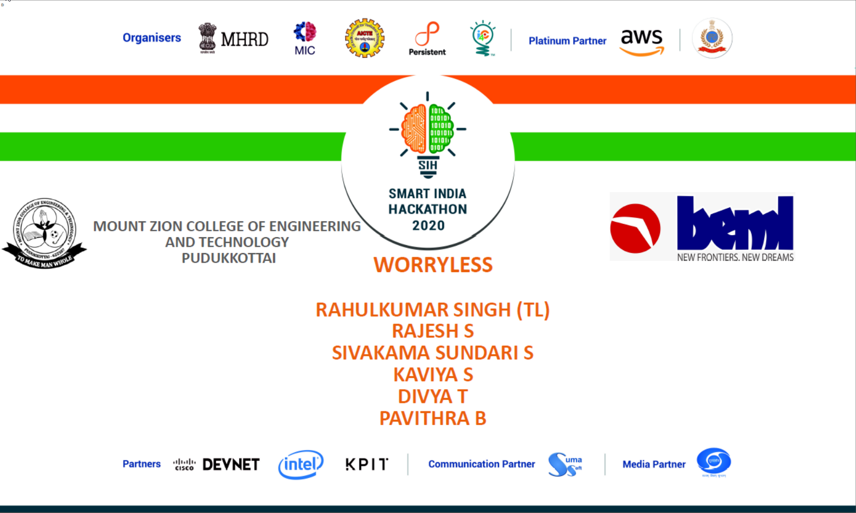

Slide 2
BH60M & BH100 with Electronic Transmission
Securing the CAN J1939 2.0B Communication Protocol, to make RIDES SAFER!

Slide 3

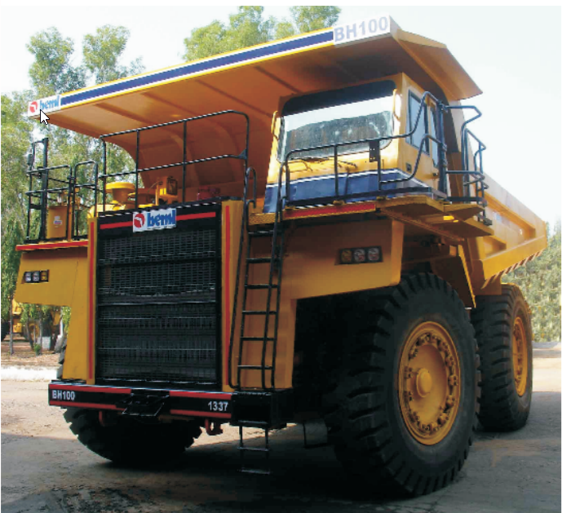
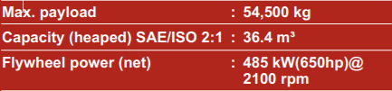
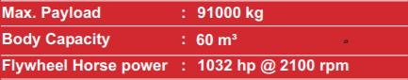

Slide 4
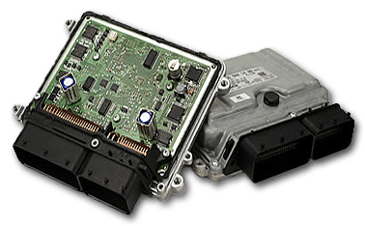
Description of the Problem
The ECUs
Electronic Control Units (ECUs) embedded in engine, transmission.
ECUs used for monitoring, display, store, control application.
ECUs are PROGRAMMABLE, hence VULNERABLE.

Slide 5
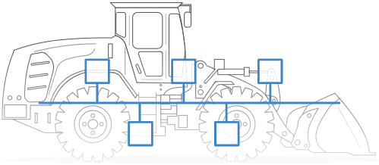
Description of the Problem
CAN J1939 2.0B
ECUs sends vital/critical data over CAN J1939 2.0B communication protocol.
CAN bus : Protocol that allows devices to communicate with each other in a vehicle.
SAE J1939 : Set of standards that define how ECUs communicate via the CAN bus in heavy duty vehicles.

Slide 6
Objective of the Project
Unauthorised access and manipulation of the CAN J1939 2.0B bus.
Unauthorised access and manipulation of the ECUs.
Implementation of Security measures.

Slide 7
Project Life Cycle
04
Unauthorised Access
Implement Security
We implement security measures.
We try to gain unauthorised access of CAN bus and ECUs.
01
03
Reverse Engineering
Attack
We reverse engineer our findings.
Based on the data we have, we manipulate the victim vehicle.
02

Slide 8
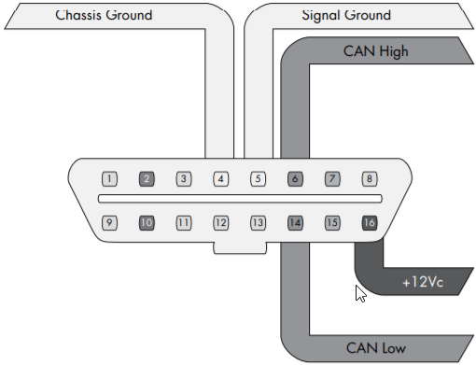
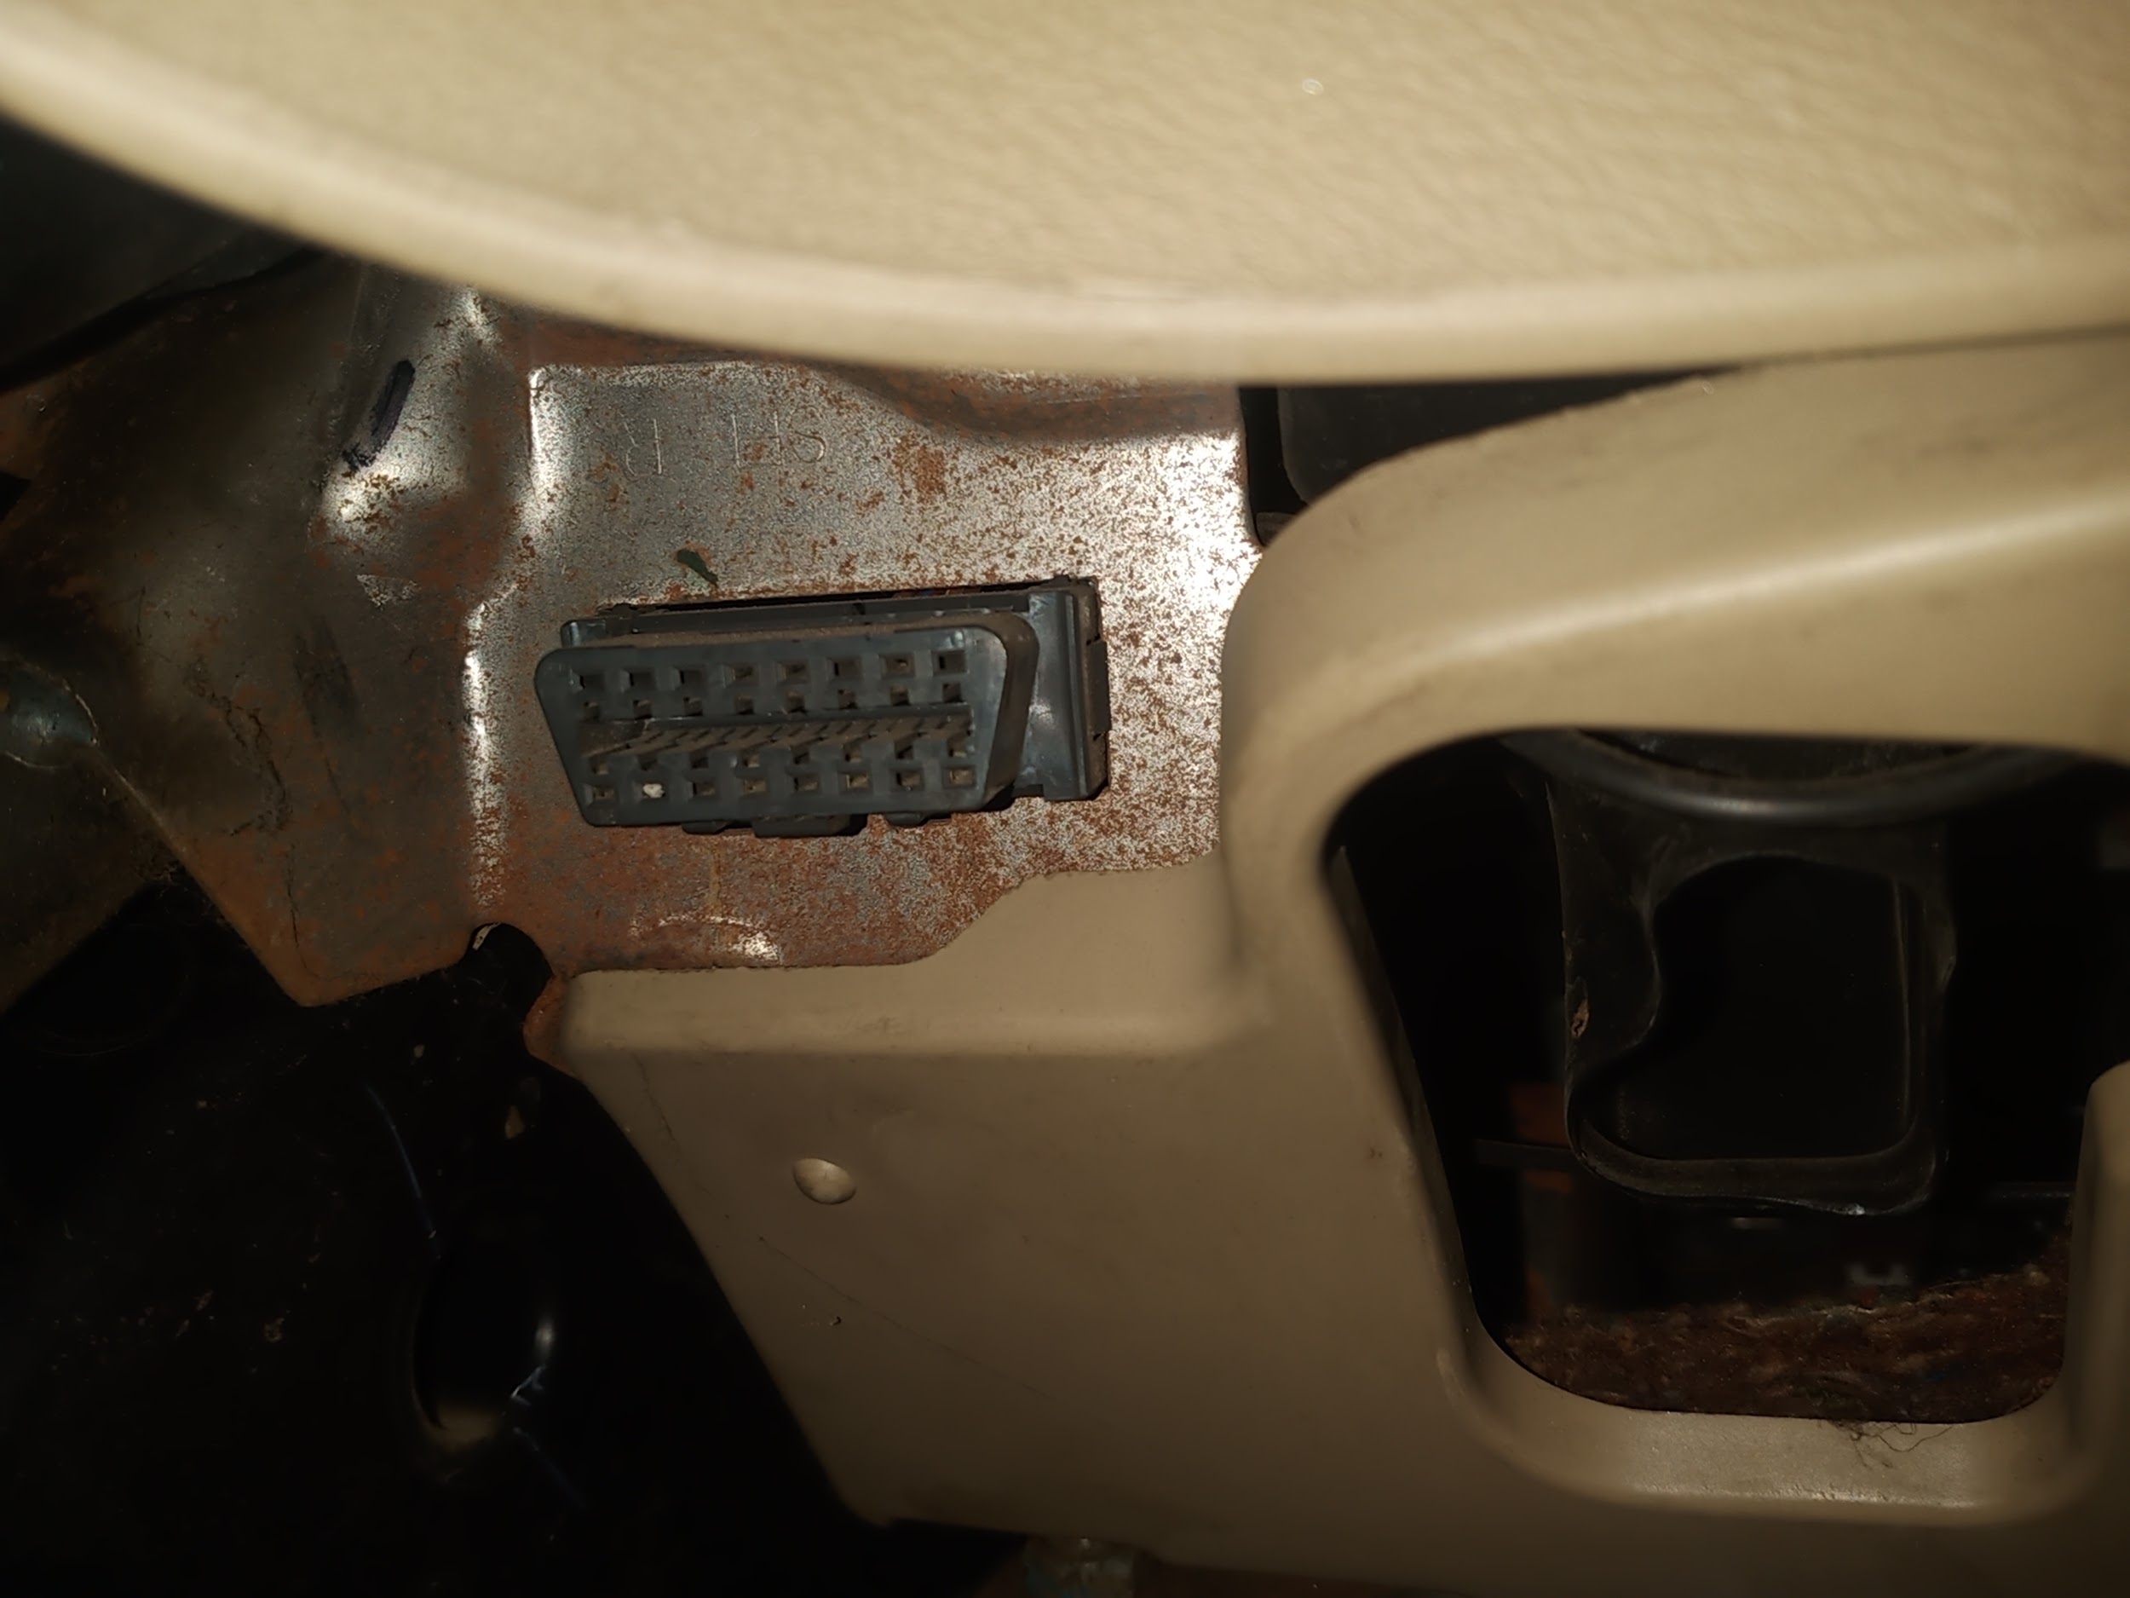
Unauthorised access and Manipulation of the CAN J1939 2.0B bus
01
Gaining Unauthorised Access and Retrieving Data:
Through OBD2 port (Opted to use)
Ripping off the CAN bus wires
Through the termination end
Remotely
OBD2 Port
OBD2 Port in our Demo Vehicle

Slide 9
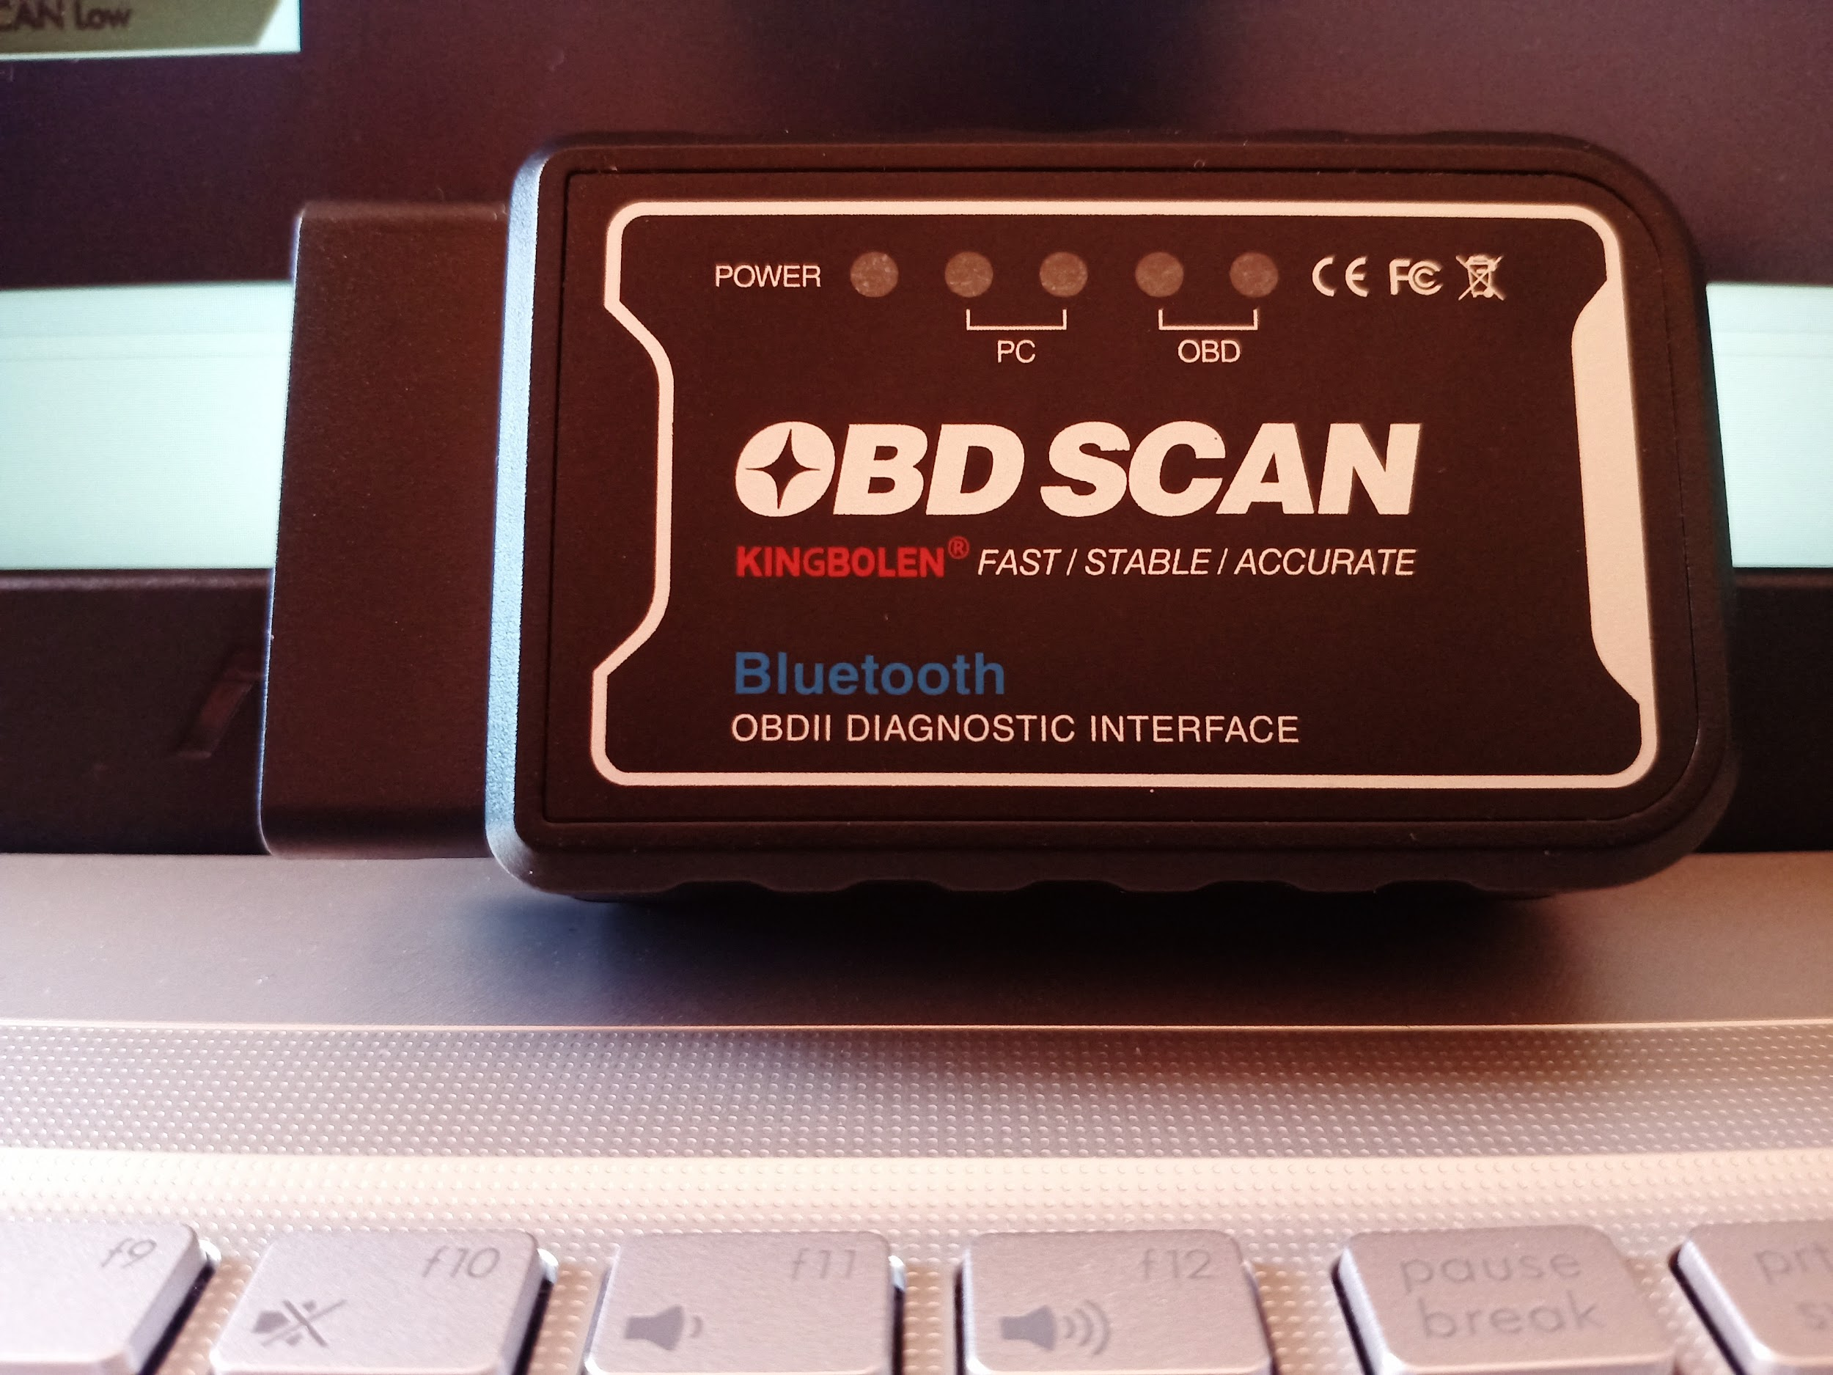

Unauthorised access and Manipulation of the CAN J1939 2.0B bus
01
Gaining Unauthorised Access and Retrieving Data:
OBD2 Port Bluetooth Adapter
Live Simulation Video

Slide 10
Unauthorised access and Manipulation of the CAN J1939 2.0B bus
02
Reverse Engineering: Using Asammdf 5.19.3
CAN J1939 2.0B Raw Data
Reverse Engineered using J1939 DBC

Slide 11
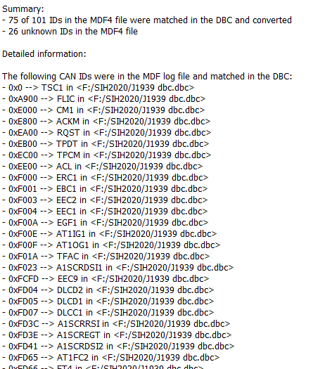
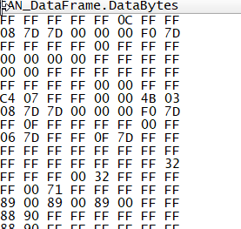
Unauthorised access and Manipulation of the CAN J1939 2.0B bus
03
Altering CAN Data and Manipulating the Vehicle.

Slide 12
Unauthorised Access and Manipulation of the ECUs.
Various Methods:
Front Door Attack
Back Door Attack
Exploits
Reversing Automotive Firmware

Slide 13
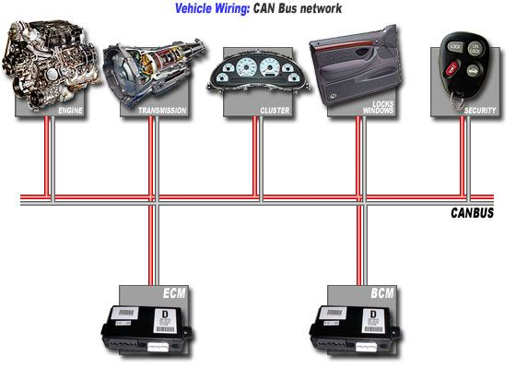
Implementation of Security measures.
Network Segmentation:
All ECUs are connected serially with CAN bus.
Once hacked, all devices are vulnerable.
Network Segmentation prevents it.
R&S
R&S
R&S
BEFORE
AFTER

Slide 14


Implementation of Security measures.
Encryption and Decryption
Develop own simple yet strong encryption - decryption algorithm
Make sure, speed of the transmission is not compromised
Encryption
#06F – 87AB - 1233
KHJDFHADSJFKHJD
Raw CAN J1939 2.0B Data
Encryption Key
Algorithm
Cipher text
Decryption
KHJDFHADSJFKHJD
#06F – 87AB - 1233
Raw CAN J1939 2.0B Data
Decryption Key
Algorithm
Cipher text

Slide 15

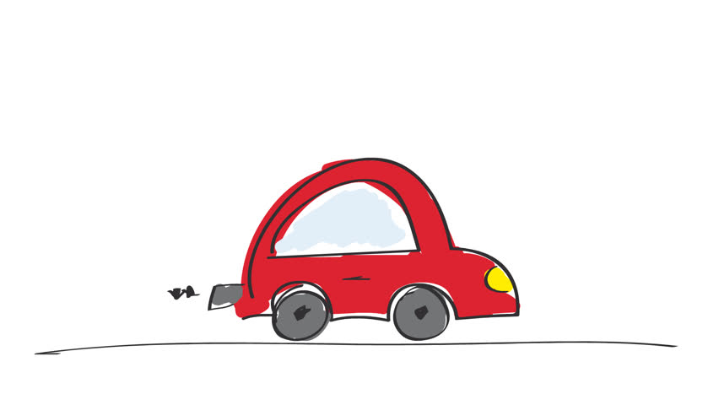
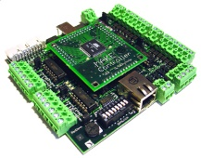
Implementation of Security measures.
Proxy and Firewall:
Develop own mechanism that identifies foreign device.
Deny service to foreign devices and alert when network is manipulated.
Foreign Device
Inside the Vehicle
Firewall & Proxy
Deny Service and Alert

Slide 16

Outcome
Know all the possibilities of hacking into a vehicle.
Implement security measures with respect to hacking techniques.
Avoid intentional accidents.
Makes rides safer, mentally as well as physically.
Avoids data theft.

Slide 17
Implementation of Security measures.
Proxy and Firewall:
Develop own mechanism that identifies foreign device.
Deny service to foreign devices and alert when network is manipulated.
Foreign Device
Inside the Vehicle
Firewall & Proxy
Deny Service and Alert

Slide 18
Conclusion
As we know, Nothing on Earth is Perfect!
Though our project might not be perfect, but it would surely make
COMPANY HAPPY :)
RIDERS HAPPY :)
HACKER SAD ;(

Slide 19
THANK YOU

